Slide 1
DATA SCIENCE Class 1: Introduction and Tools
Notes:
~15-20 min on initial stuff
Note: example DS problem…write down some features, how could you build a predictive model from these?

Slide 2
WELCOME!
INTRO TO DATA SCIENCE
Notes:
Introductions
discuss student backgrounds
discuss reasons for interest in data science

Slide 3
agenda
Introduction
Data Science
Course Overview
Technical Review
Unix Commands
Git
Ipython
Data Exploration
Visualizations
Notes:
All of our classes will involve some hands-on work (in the exercises section)

Slide 4
Intros
INTRO TO DATA SCIENCE
Notes:
~15-20 min for this section?

Slide 5
INTROS
Someone else in the room has the same number as you do. Find them! Only rule is each of you needs to ask each other one question before comparing numbers:
If you had to give up a favorite food, which would be the hardest?
Favorite color, and why
What do you do if someone says “I could care less”
Strangest thing you’ve eaten, and when
When someone says “Good question”, what do you think it means?
Longest you’ve gone without sleeping?
Anything else!
Notes:
~15-20 min for this section?

Slide 6
INTROS
Who are you?
What’s your name?
Why are you taking this course?
Which company, in your opinion, has the coolest data?
What is one item that you should really throw away but haven’t?
Notes:
~15-20 min for this section?

Slide 7
I. What is data science?
INTRO TO DATA SCIENCE
Notes:
~15-20 min for this section?

Slide 8
What is DATA SCIENCE?
Wikipedia: “Data science is the interdisciplinary field about process and systems to extract knowledge or insights from data in various forms, either structured or unstructured, which is a continuation of some of the data analysis fields such as statistics, data mining, and predictive analysis”
Notes:
This is pretty high level
Q: what kinds of tools & techniques do you think this means? (subject of this course…”useful” depends on the particular problem)
in general, DS is used to make intelligent decisions (frequently to satisfy business requirements)
Q: does anyone know of any examples?

Slide 9
What is DATA SCIENCE?
A set of tools and techniques used to extract useful information from data.
Notes:
This is pretty high level
Q: what kinds of tools & techniques do you think this means? (subject of this course…”useful” depends on the particular problem)
in general, DS is used to make intelligent decisions (frequently to satisfy business requirements)
Q: does anyone know of any examples?

Slide 10
What is DATA SCIENCE?
A set of tools and techniques used to extract useful information from data.
An interdisciplinary, problem-solving oriented subject.
Notes:
Combines math, computing, problem solving skills, communication
Practical subject, not very formal/rigorous.
Problem solving skills are key!

Slide 11
What is DATA SCIENCE?
A set of tools and techniques used to extract useful information from data.
An interdisciplinary, problem-solving oriented subject.
The application of scientific techniques to practical problems.
Notes:
Scientific = math & computing as above…practical = important to biz (etc)
Not a rigid, axiomatic discipline…lots of stuff is new & still-evolving.

Slide 12
What is DATA SCIENCE?
A set of tools and techniques used to extract useful information from data.
An interdisciplinary, problem-solving oriented subject.
The application of scientific techniques to practical problems.
A rapidly growing field.
Notes:
You’re here because you’ve heard of it & you want to know more!

Slide 13











who uses data science?
Notes:
Lots of names you’d expect (also obama, nyt → politics = growth area)
Q: can you think of any others? → show some example in the browser
Soon the question will be: who doesn’t use data science?

Slide 14

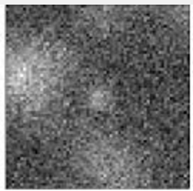
TYPES OF DATA SCIENCE PROBLEMS
Cancer?
Notes:
Lots of names you’d expect (also obama, nyt → politics = growth area)
Q: can you think of any others? → show some example in the browser
Soon the question will be: who doesn’t use data science?

Slide 15


TYPES OF DATA SCIENCE PROBLEMS
What kind of website?
Notes:
Lots of names you’d expect (also obama, nyt → politics = growth area)
Q: can you think of any others? → show some example in the browser
Soon the question will be: who doesn’t use data science?

Slide 16

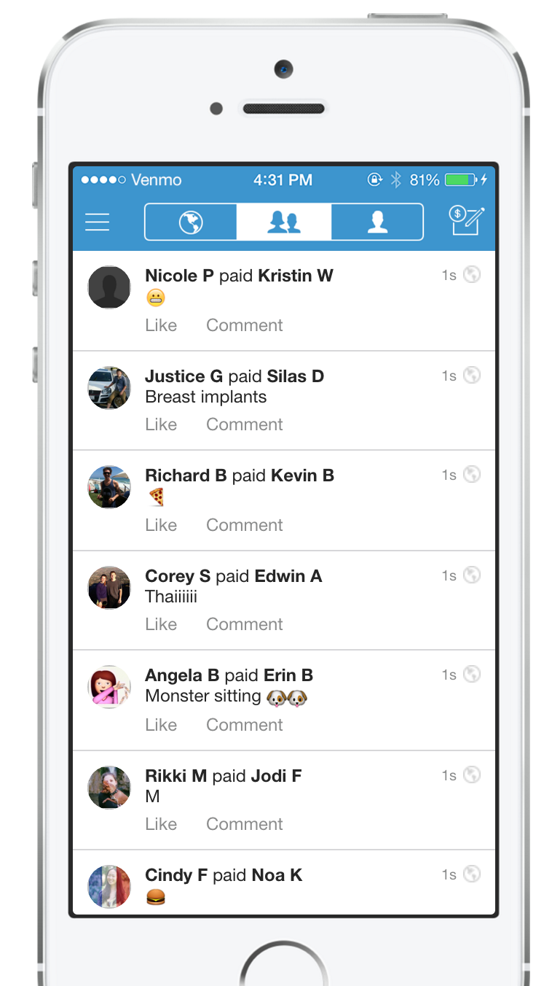
TYPES OF DATA SCIENCE PROBLEMS
Fraudster?
Notes:
Lots of names you’d expect (also obama, nyt → politics = growth area)
Q: can you think of any others? → show some example in the browser
Soon the question will be: who doesn’t use data science?

Slide 17
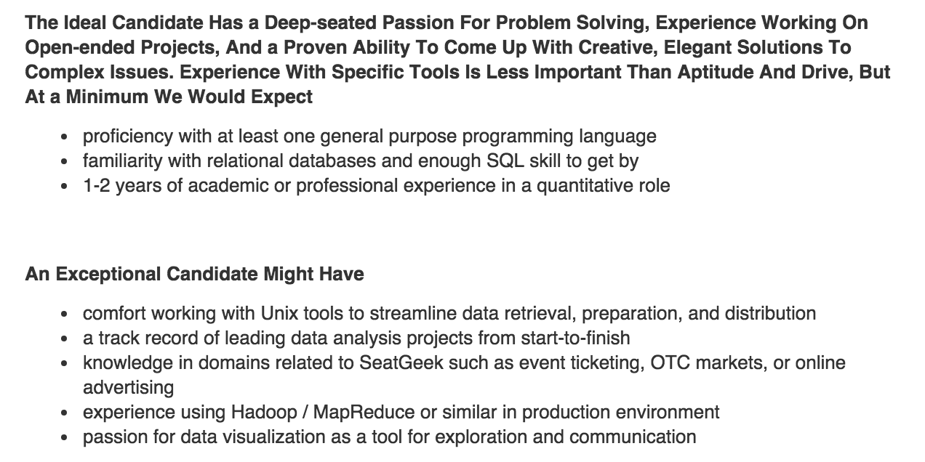

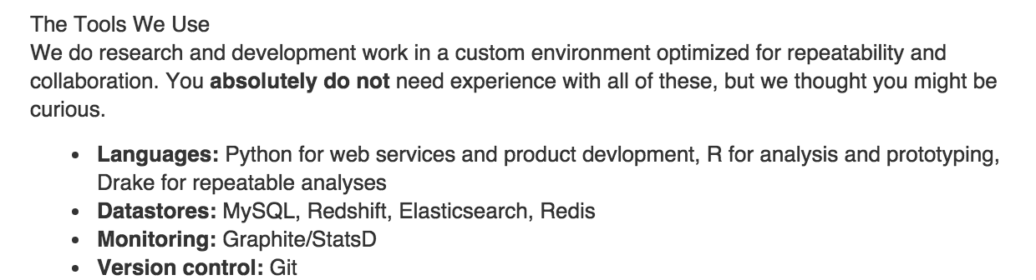
What are people looking for?

Slide 18
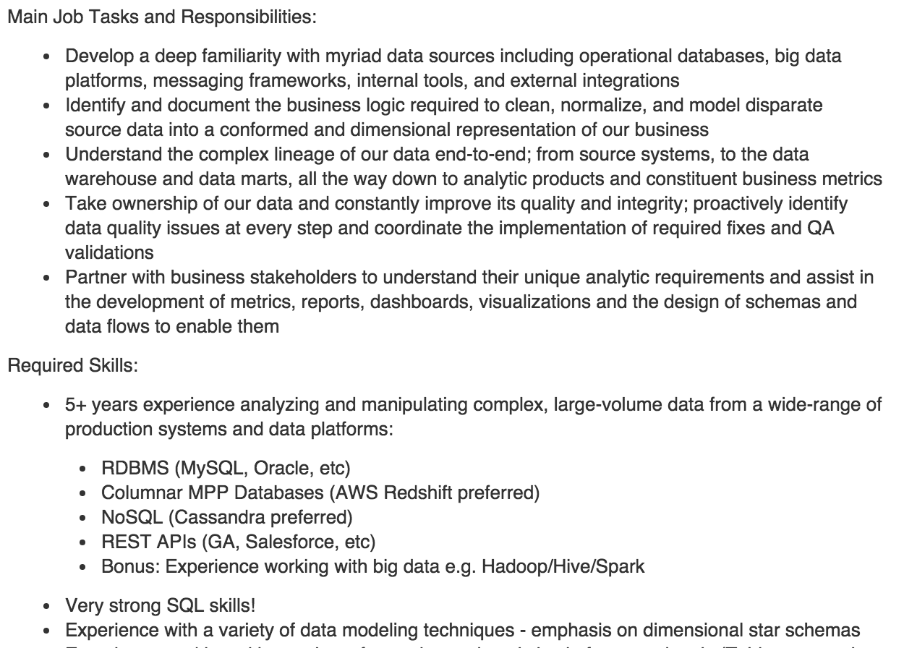

What are people looking for?

Slide 19


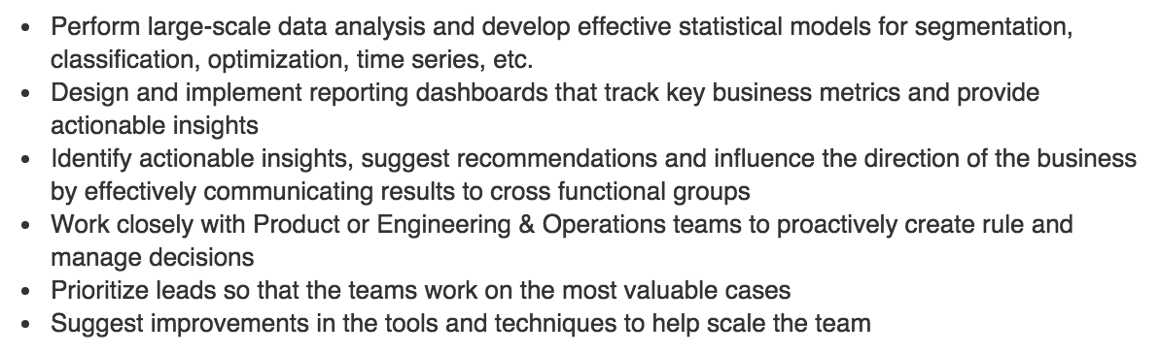

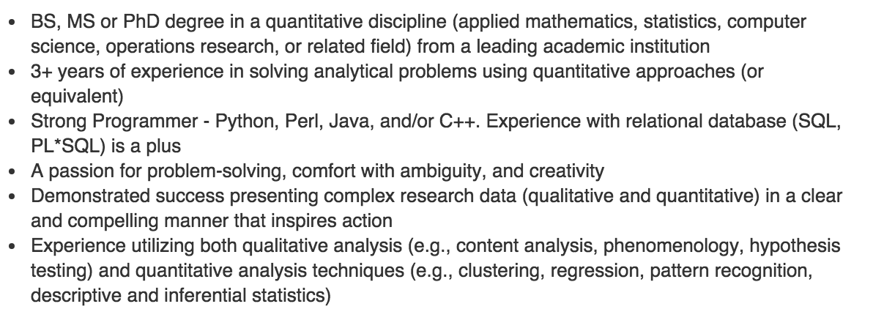
What are people looking for?

Slide 20
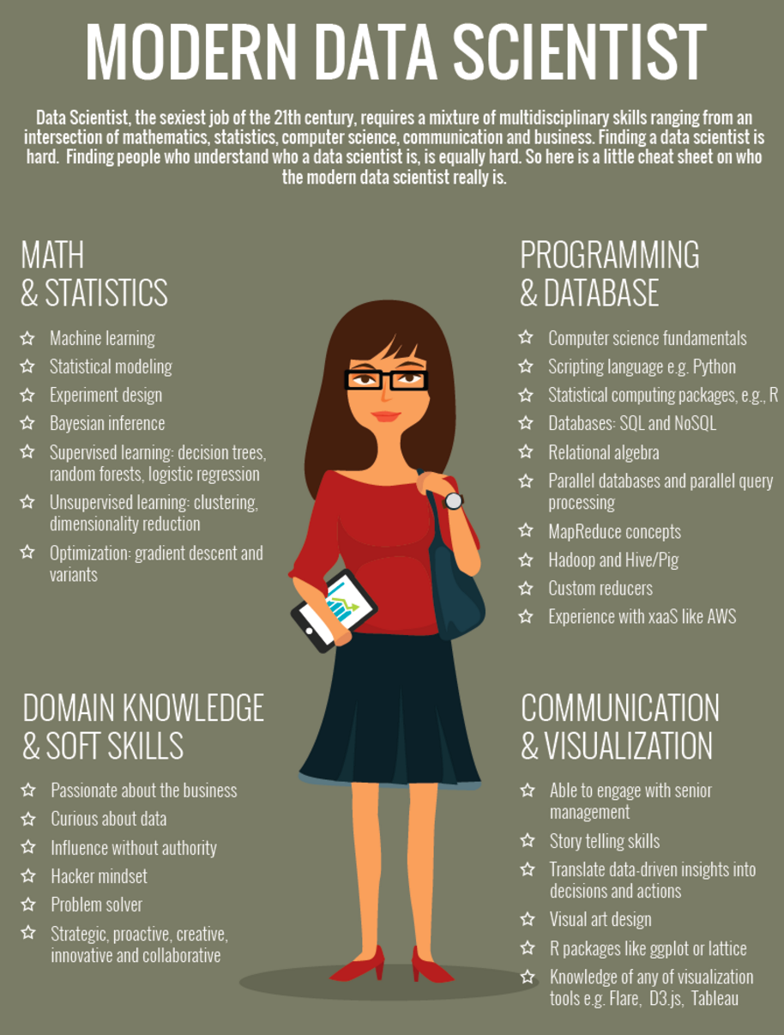
What makes a good data scientist?
http://www.marketingdistillery.com/2014/11/29/is-data-science-a-buzzword-modern-data-scientist-defined/
Notes:
Lots of names you’d expect (also obama, nyt → politics = growth area)
Q: can you think of any others? → show some example in the browser
Soon the question will be: who doesn’t use data science?

Slide 21
What makes a good data scientist?
Notes:
Lots of names you’d expect (also obama, nyt → politics = growth area)
Q: can you think of any others? → show some example in the browser
Soon the question will be: who doesn’t use data science?

Slide 22
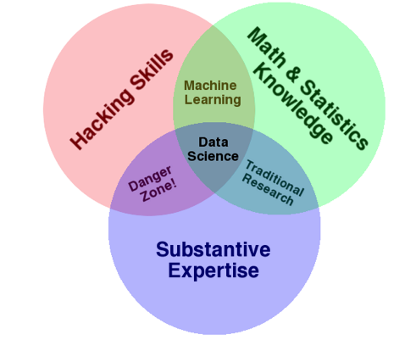
The qualities of a data scientist
source: http://www.dataists.com/2010/09/the-data-science-venn-diagram/
Notes:
Q: what could go wrong in the danger zone?

Slide 23
Ii. The data science workflow
INTRO TO DATA SCIENCE
Notes:
~15-20 min for this section?
So what does data science look like?

Slide 24
the data science workflow
from Jeff Hammerbacher:
1. Identify problem
2. Instrument data sources
3. Collect data
4. Prepare data (integrate, transform, clean, impute, filter, aggregate)
5. Build model
6. Evaluate model
7. Communicate results
source: http://berkeleydatascience.files.wordpress.com/2012/01/20120117berkeley1.pdf
Notes:
Fits into our earlier characterization pretty well (problem solving skills necessary throughout!)
New headers connected to visualization (part of communication)
Q: are these in order? (A: there really is no order)

Slide 25
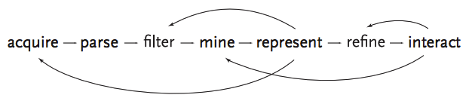
the data science workflow
source: http://benfry.com/phd/dissertation-110323c.pdf
ZIPDECODE
Notes:
Solving problems iteratively: not a straight line (eg, there’s really no correct order)
Start small & work your way out…Don’t try to do everything in a single step!
Q: why not?

Slide 26


Getting the data example
ETL
SQL DB
SQL DB REPLICA
ETL
OPERATIONAL DATA STORE (ODS)
DATA WAREHOUSE
ETL
NOSQL DB
NOSQL DB REPLICA
*ETL: EXTRACT, TRANSFORM, LOAD
Notes:
Solving problems iteratively: not a straight line (eg, there’s really no correct order)
Start small & work your way out…Don’t try to do everything in a single step!
Q: why not?

Slide 27

Getting the data example
ETL
SQL DB
SQL DB REPLICA
ETL
OPERATIONAL DATA STORE (ODS)
DATA WAREHOUSE
ETL
Data Scientists often spend (too) much of their time dealing with complicated ETL processes
NOSQL DB
NOSQL DB REPLICA
*ETL: EXTRACT, TRANSFORM, LOAD
Notes:
Solving problems iteratively: not a straight line (eg, there’s really no correct order)
Start small & work your way out…Don’t try to do everything in a single step!
Q: why not?

Slide 28
Visualizing the data
Visualization & Communication are critical components to effective data storytelling
Examples:
- “11,419 people killing in 2013” vs Periscope
- “10% of users visit a the home page of a certain site and then stop” vs sunburst viz
Notes:
Solving problems iteratively: not a straight line (eg, there’s really no correct order)
Start small & work your way out…Don’t try to do everything in a single step!
Q: why not?

Slide 29
In class workflow problem
10 minutes: You work for a mobile payments company and have a problem: Many of your users type in a user’s name but sometimes pay the wrong person if the name is common (i.e. pay the wrong John Smith)! Describe the workflow of a data scientist who is attempting to solve this issue.
Notes:
Solving problems iteratively: not a straight line (eg, there’s really no correct order)
Start small & work your way out…Don’t try to do everything in a single step!
Q: why not?

Slide 30
COURSE OVERVIEW
INTRO TO DATA SCIENCE
Notes:
~45 min?
Let’s do some warmups before we start hacking at our first dataset

Slide 31
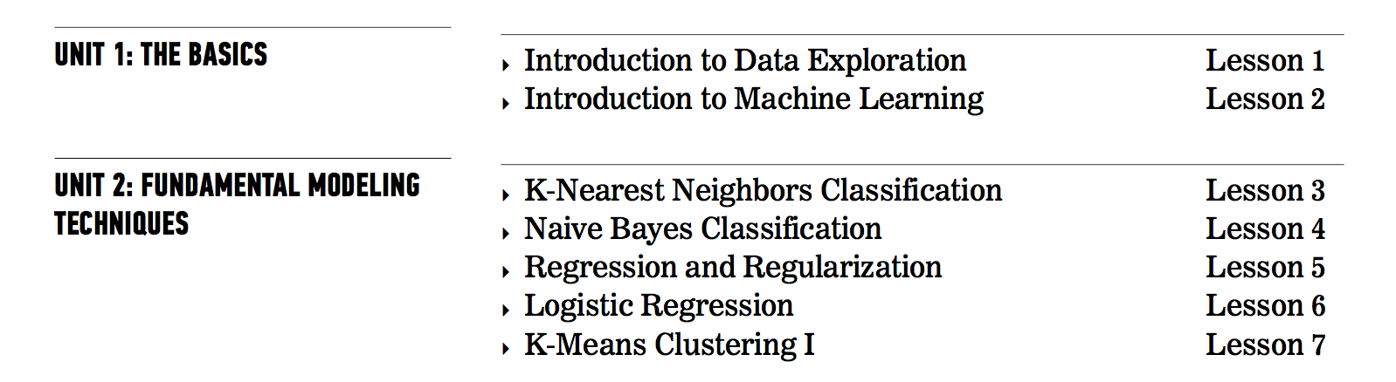
COURSE OVERVIEW
Notes:
Solving problems iteratively: not a straight line (eg, there’s really no correct order)
Start small & work your way out…Don’t try to do everything in a single step!
Q: why not?

Slide 32
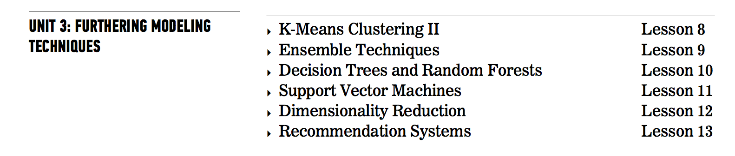
COURSE OVERVIEW
Notes:
Solving problems iteratively: not a straight line (eg, there’s really no correct order)
Start small & work your way out…Don’t try to do everything in a single step!
Q: why not?

Slide 33
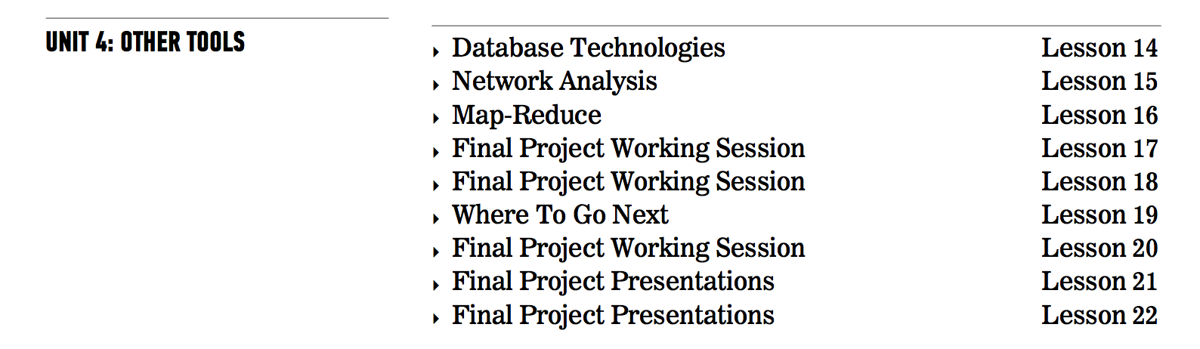
COURSE OVERVIEW
Notes:
Solving problems iteratively: not a straight line (eg, there’s really no correct order)
Start small & work your way out…Don’t try to do everything in a single step!
Q: why not?

Slide 34
Computer setup
INTRO TO DATA SCIENCE
Notes:
~45 min?
Let’s do some warmups before we start hacking at our first dataset

Slide 35
Computer setup
Have you:
Installed python (anaconda)
Create a Git account, downloaded Git, and set global config (https://git-scm.com/book/en/v2/Getting-Started-First-Time-Git-Setup)
Installed cygwin (windows)
Launched ipython notebook
Able to import:
Scikit-learn
Numpy
Pandas
nltk
Statsmodels
matplotlib
Notes:
These are some initial very *practical* command line tools…we will be using these regularly & seeing many more as the course progresses (discuss why to do this before loading into R/Python)
Q: are any of these unfamiliar? Can you think of any other important basic tools?
Q: who has heard of/used vim, emacs, gnuplot, numpy/scipy/pandas, homebrew, tmux, julia? Just (to get an idea of the pace of the class)

Slide 36
IiI. working at the unix command line
INTRO TO DATA SCIENCE
Notes:
~45 min?
Let’s do some warmups before we start hacking at our first dataset

Slide 37

Exercise – working at the unix command line
Key objectives
tools
- Navigate the filesystem
- Create, move, copy, and delete files & directories
- View & search files
- Edit & interact with files
- Combine steps
- Learn more
- ls, cd
- cat, touch, mv, cp, mkdir, rm, rmdir
- head, tail, less, cat, grep
- vim, tr, sort, uniq, wc
- pipe (|)
- man, apropos
NOTE
Being comfortable at the command line makes your life much easier!
Notes:
These are some initial very *practical* command line tools…we will be using these regularly & seeing many more as the course progresses (discuss why to do this before loading into R/Python)
Q: are any of these unfamiliar? Can you think of any other important basic tools?
Q: who has heard of/used vim, emacs, gnuplot, numpy/scipy/pandas, homebrew, tmux, julia? Just (to get an idea of the pace of the class)

Slide 38
Other tools
INTRO TO DATA SCIENCE
Notes:
~45 min?
Let’s do some warmups before we start hacking at our first dataset

Slide 39
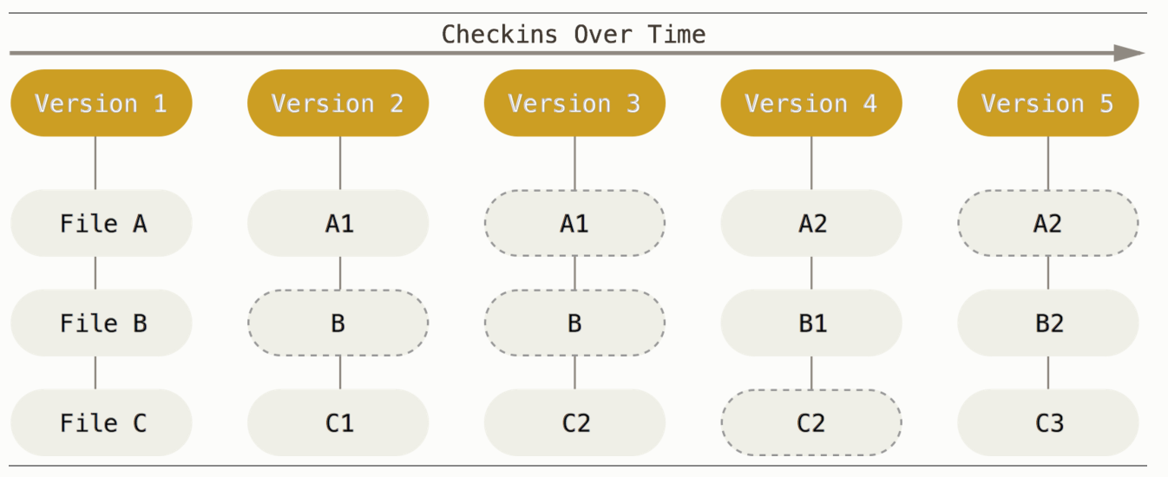
git
Git is a version control system. It stores a copy of all changes you make to files over time
Notes:
~15-20 min for this section?

Slide 40
git
Main commands:
git clone <repo name>
This command copies all the code from a given repo
git pull
This command updates all changes made to a repo since you last cloned
Notes:
~15-20 min for this section?

Slide 41
In class work
Lab time: pull the class directory and work on the lab found in class #1
Notes:
~15-20 min for this section?

